Slide 1
Spring Boot
Breakout: Coding the many-to-many relationship in JPA

Slide 2
What's in this video...
The difference between a unidirectional many-to-many relationship and a bidirectional many-to-many relationship
Coding a unidirectional many-to-many relationship
Coding a bidirectional many-to-many relationship

Slide 3
Bidirectional many-to-many
In a bidirectional many-to-many relationship, there is a relationship "owner"
The "owner" defines the join table using the @JoinTable annotation
The "owned" entity uses the "mappedBy" attribute to point to the instance variable (Set, List) in the owner

Slide 4
Bidirectional many-to-many
For a bidirectional relationship, each entity "knows" about the other
@Entity
class Owner {
@ManyToMany(cascade = PERSIST)
@JoinTable(...)
Set<Owned> owned = new HashSet<>();
}
@Entity
class Owned {
@ManyToMany(mappedBy = "owned")
Set<Owner> owners = new HashSet<>();
}

Slide 5
Many-to-many
Spring JPA creates a join table to map from owner to owned
This is true for the unidirectional many-to-many as well
owner_id | owned_id
1 | 1
1 | 2
2 | 3

Slide 6
@JoinTable annotation
@JoinTable(
name = "join_table_name",
joinColumns =
@JoinColumn("owner_column"),
inverseJoinColumns =
@JoinColumn("owned_column")
)
If you don't specify the @JoinTable annotation, JPA will create one with default names
Used by both unidirectional and bidirectional many-to-many relationships

Slide 7
Getting the join to work
When inserting a parent with child rows:
Bidirectional:
The child objects must be set in the parent and the parent must be set in all the child objects
Unidirectional:
The child objects must be set in the parent

Slide 8
Unidirectional many-to-many
In a unidirectional many-to-many relationship, there is a relationship "owner", which knows about the "owned" entity
The "owner" defines the join table using the @JoinTable annotation
The "owned" entity does not know about the "owner"

Slide 9
Unidirectional many-to-many
@Entity
class Owner {
@ManyToMany(cascade = PERSIST)
@JoinTable(...)
Set<Owned> owned = new HashSet<>();
}
@Entity
class Owned {
// No reference to "Owner"
}

Slide 10
What are we coding in this video project?
Both projects use the same tables
A bunny breed and description schema

Slide 11
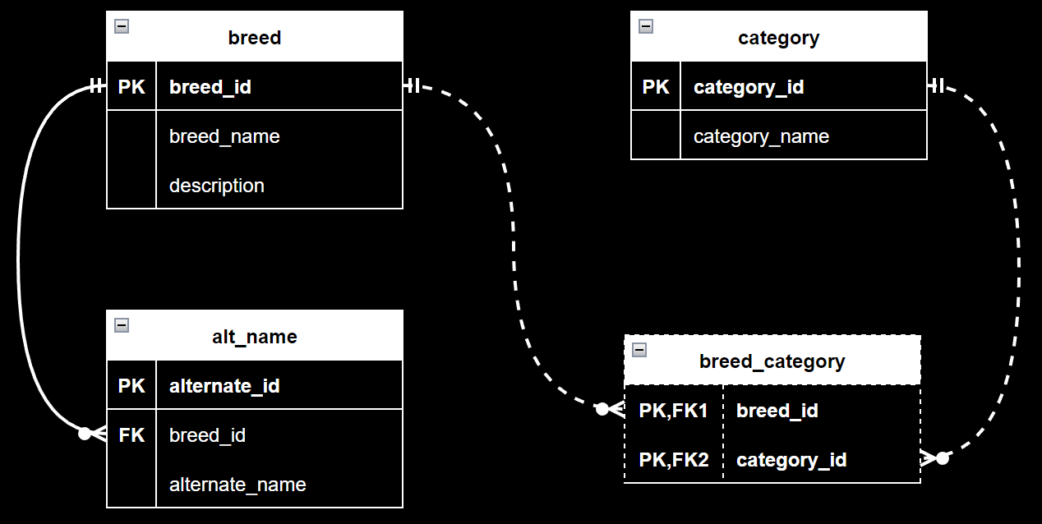

Slide 12
Let's code it!

